Slide 1
Copy Move Forgery Detection
Brady Sheehan

Slide 2
Outline
Problem/Background
Algorithm
Results

Slide 3
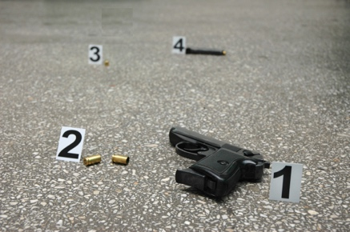
Is this photo real?
Photo courtesy of: https://mexicoinstitute.wordpress.com/tag/crime/

Slide 4
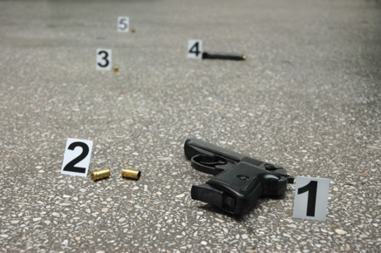
Is this photo real? - No!
Photo courtesy of: https://mexicoinstitute.wordpress.com/tag/crime/

Slide 5
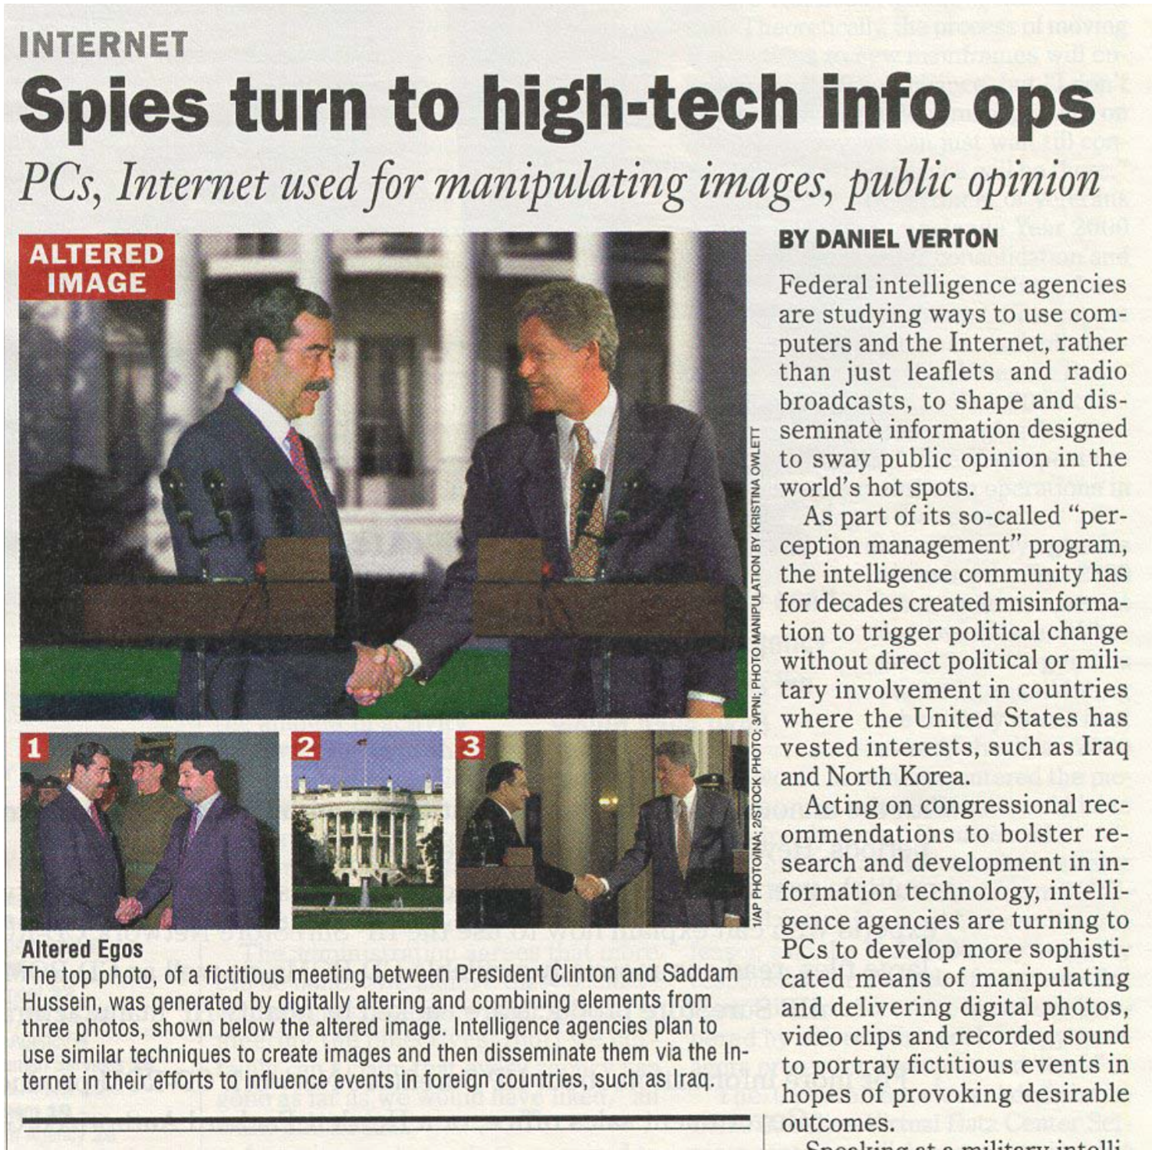
Problem – Image Manipulation
Increase in accessible software for image manipulation has made forgeries common place
Photo courtesy of: J.Fridrich, D. Soukal, and J. Lukas. Detection of Copy-Move Forgery in digital Images. Proc. Of Digital Forensic Research Workshop, Aug. 2003.

Slide 6
Verifying the authenticity of photos
It can be very difficult to see that a photo is real just by looking at it
In rare cases, the authenticity of a photo could be the difference between a conviction or release
Need a method for assisting in verification that a photo has not been tampered
Need to classify types of image forgery

Slide 7
Image Forgery
Field broke into three broad categories
Tampering - adjusting brightness or removing imperfections
Splicing - two or more images combined to form one (or cropping)
Cloning or Copy-Move - a region of an image is copied and placed over a different region of the image
Can we detect images that have fallen into category three?
How can we identify which regions of the image have been modified?
Notes:
In a Copy-Move forgery, a part of the image itself is copied and pasted into another part of the same image. This is usually performed with the intention to make an object “disappear” from the image by covering it with a segment copied from another part of the image. Textured areas, such as grass, foliage, gravel, or fabric with irregular patterns, are ideal for this purpose because the copied areas will likely blend with the background and the human eye cannot easily discern any suspicious artifacts. Because the copied parts come from the same image, its noise component, color palette, dynamic range, and most other important properties will be compatible with the rest of the image and thus will not be detectable using methods that look for incompatibilities in statistical measures in different parts of the image. To make the forgery even harder to detect, one can use the feathered crop or the retouch tool to further mask any traces of the copied-and-moved segments.

Slide 8
Goal and Solution Requirements
Copy-move forgeries introduce correlation between copied region and pasted region
Capitalize on this correlation to detect image forgery
Formulate the following requirements for any detection algorithm
Allow for approximate matches of small segments
Speed vs Effectiveness (minimizing false positives)
Copied region should appear as a collection of small patches or pixels rather than a single block

Slide 9
A Simple Algorithm
Brute force solution:
For all n x n sliding windows of the image
If match
Mark those them as a possible copy/move pair
Problems
Many false positives
Space and time complexity
Is not invariant to noise, scaling, rotation, or other modifications in the copied region
It does not satisfy assumption of regions being copied together

Slide 10
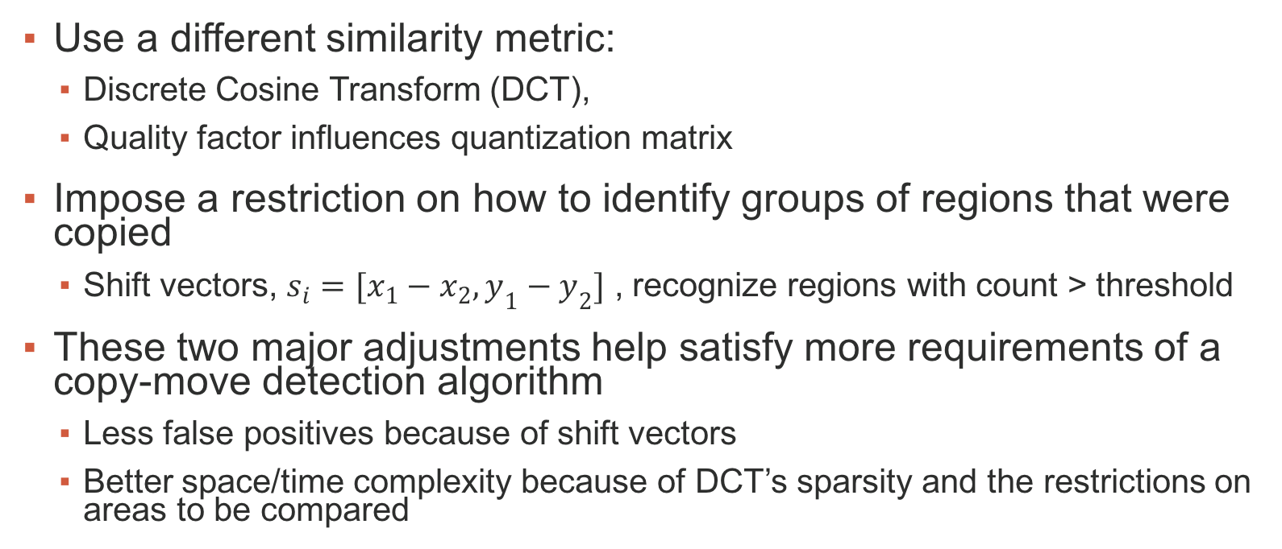
Better Solution – Basic Idea
Use a different similarity metric:
Discrete Cosine Transform (DCT),
Quality factor influences quantization matrix
Impose a restriction on how to identify groups of regions that were copied
Shift vectors, $s_{i}=[x_{1}−x_{2},y_{1}−y_{2}]$ , recognize regions with count > threshold
These two major adjustments help satisfy more requirements of a copy-move detection algorithm
Less false positives because of shift vectors
Better space/time complexity because of DCT’s sparsity and the restrictions on areas to be compared
Algorithm first appeared in J.Fridrich, D. Soukal, and J. Lukas. Detection of Copy-Move Forgery in digital Images. Proc. Of Digital Forensic Research Workshop, Aug. 2003.
Notes:
Instead of comparing regions based on the whole patch, let’s try to compare regions based on some piece of information that represents the patch.
Also, we need to impose some restriction on how we identify groups of regions that were copied.
Idea: take DCT of each patch – which will find the most significant information for representing all the information in that patch (nothing less) and introduce a lot of sparcity in the data (which helps with space complexity)
Instead of just checking if two blocks match, let’s first check if their DCT’s match and then check how many blocks around it match. If some number blocks in that general region match, then identify it as a copy move pair.

Slide 11
Improvements to Algorithm
My implementation of their approach resulted in many false positive identifications
Adjustment: do not mark shift vectors [0,1] , [1,0] or [1,1] as copy/move regions
Improves runtime and identifies less false positives
Goal: Determine effectiveness of this algorithm on rotation and scaling in the copied-moved region

Slide 12
Results - Input
No rotation
Number 5 covered from before with regular copy/move
Photo courtesy of: https://mexicoinstitute.wordpress.com/tag/crime/

Slide 13
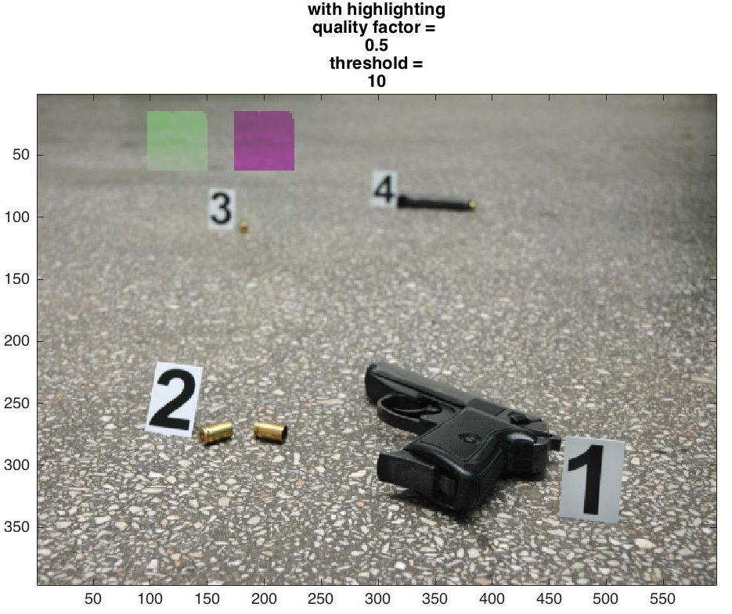
Results - Output
There is: 1 shift vectors [-0, 76]
appeared: 389 times’
Elapsed time is 27.078749 seconds.
Photo courtesy of: https://mexicoinstitute.wordpress.com/tag/crime/

Slide 14
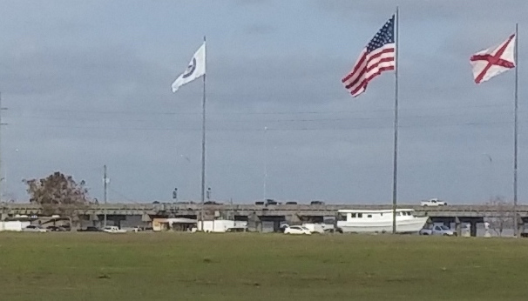
Results - Original

Slide 15
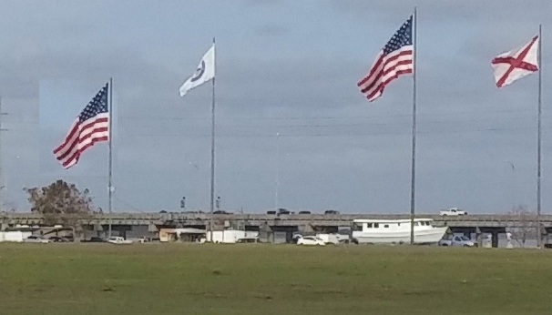
Results - Input
No rotation
Right American flag was copied and pasted above the telephone pole on the left side of the image

Slide 16
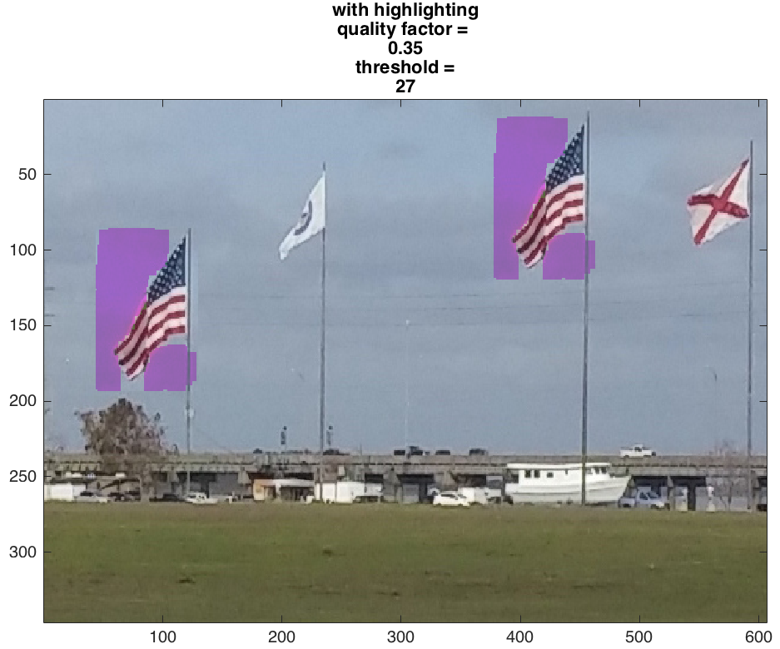
Results - Output
There are 2 shift vectors
[0,2] appeared 33 times
[74,33] appeared 334 times
Elapsed time is 17.337864 seconds.

Slide 17

Results - Original

Slide 18
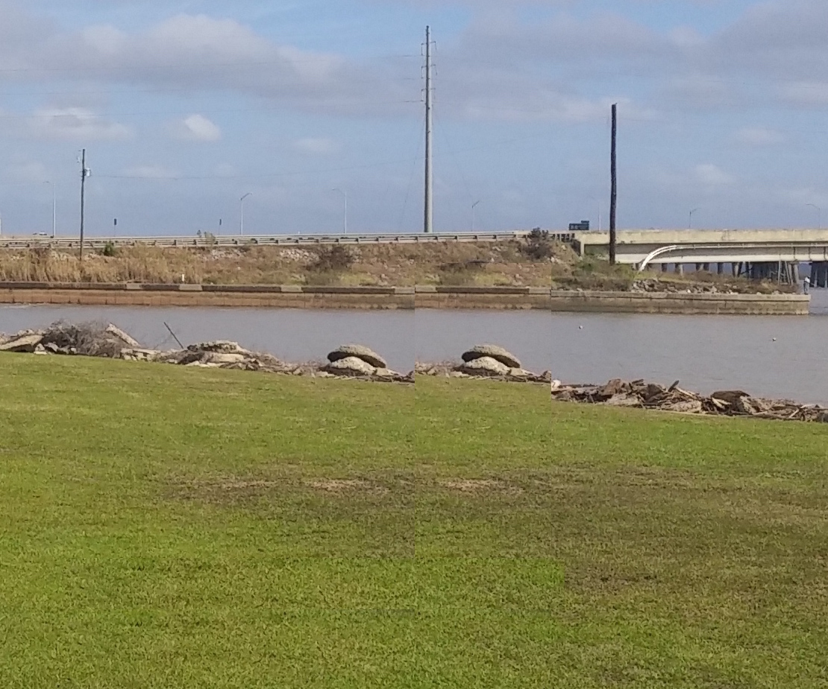
Results - Input
No rotation
Person was covered with rectangular block from left side
Shadow was covered with rectangular block below it

Slide 19
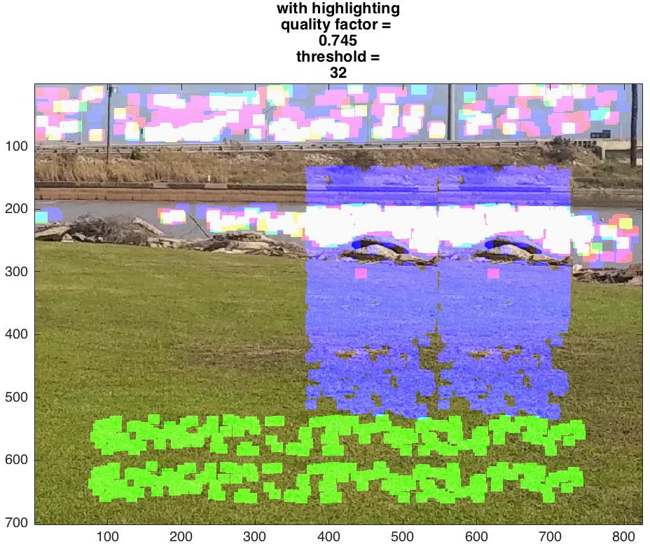
Results - Output
There are 19 shift vectors
[0,2], [3,0], [2,1], [3,1], [0,2], [1,2], [2,2], [0,3], [1,3], [75,3], [0,4], [1,4], [0,5], [0,178,], [0,179], [1,179], [0,180], [1,180], [0,181]
Elapsed time is 61.332635 seconds.
Despite noise, clearly recognizes 2 regions as copy-move forgeries

Slide 20
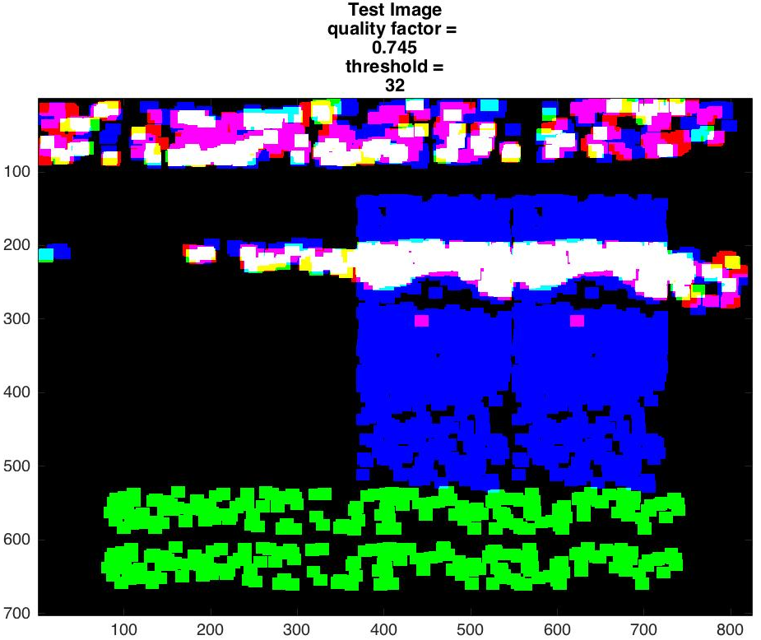
Results - Output
Image for testing purposes
Helps to acknowledge where noise is and where copy-move regions are

Slide 21
Results - Input
Rotated copied region 180 degrees
Number 5 covered from before with regular copy/move
Photo courtesy of: https://mexicoinstitute.wordpress.com/tag/crime/

Slide 22
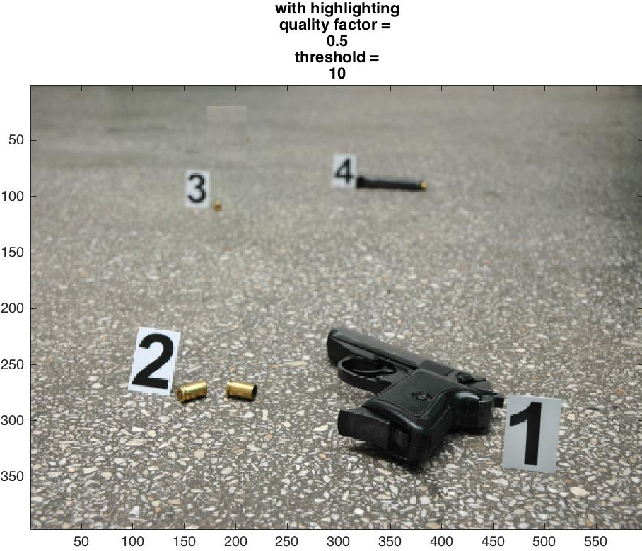
Results - Output
Found zero shift vectors
Elapsed time is 24.848731 seconds.
Tried with rotations of 90, 180, 270 and found same result
‘Test’ image showed zero shift vectors, all black every time
Photo courtesy of: https://mexicoinstitute.wordpress.com/tag/crime/

Slide 23
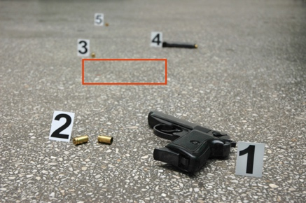
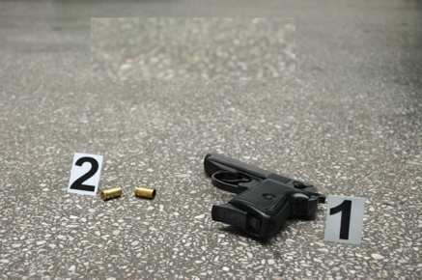
Results - Input
Scaled boxed region by 175%
Used it to cover the numbers 3, 4, and 5
Photo courtesy of: https://mexicoinstitute.wordpress.com/tag/crime/

Slide 24
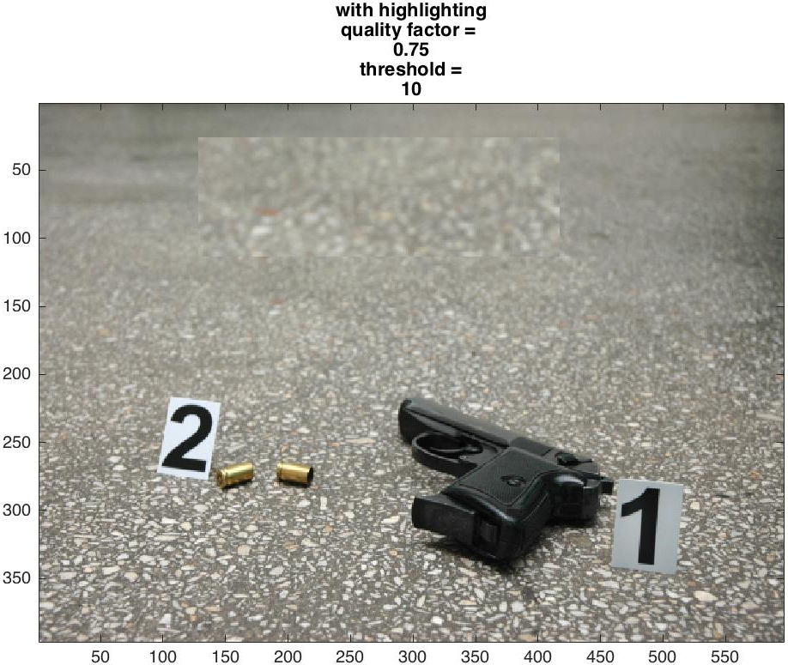
Results - Output
Found zero shift vectors
Elapsed time is 21.469056 seconds.
Tried with scaling of different sizes, never worked
‘Test’ image showed zero shift vectors, all black every time
Photo courtesy of: https://mexicoinstitute.wordpress.com/tag/crime/

Slide 25
Summary
DCT is not effective for detecting copy-move forgeries where there is rotation or scaling in the copied region
Need to identify a different image descriptor/similarity metric that can be invariant to rotation and scaling

Slide 26
References
Digital Image Forensics by Hany Farid.
J.Fridrich, D. Soukal, and J. Lukas. Detection of Copy-Move Forgery in digital Images. Proc. Of Digital Forensic Research Workshop, Aug. 2003.

